Slide 1
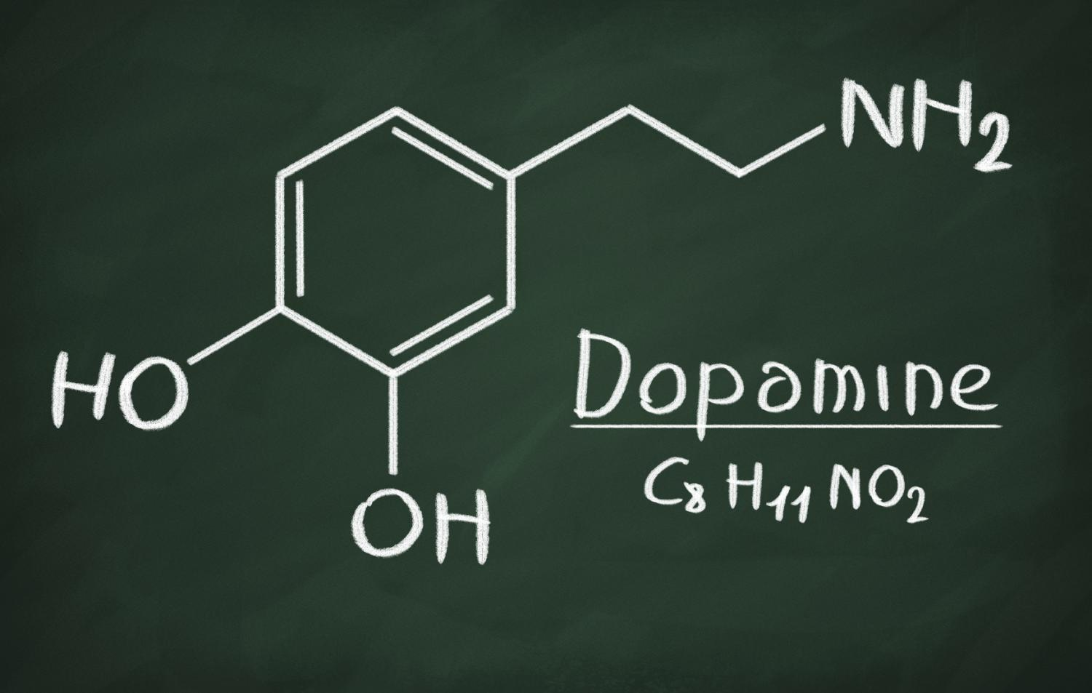
Dopamine in the reward system with relevance for addiction

Slide 2
Overview
Introduction
Dopamine in learning with focus on VTA and NAc
Drug and Food addiction

Slide 3




Slide 4
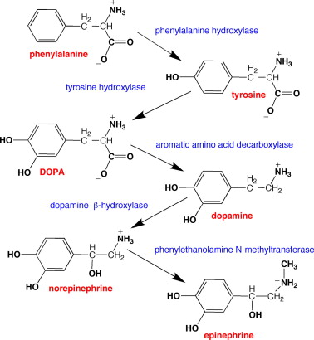
Dopamine synthesis
S.C. Daubner et al, 2011

Slide 5
Pathways & Function
- Periphery
CNS
Nigro-striatal pathway
Tuberoinfundibular pathway
Mesocortical pathway
Mesolimbic pathway
Arias-Carrion et al, 2010

Slide 6
Pathways & Function
Nigro-striatal pathway
Substantia nigra → Striatum
Motor functions
Tuberoinfundibular pathway
Hypothalamus → pituitary gland
Inhibition of prolactin production
Arias-Carrion et al, 2010

Slide 7
Pathways & Function
Mesocortical pathway
Ventral tegmental area →
Frontal cortex
Cognitive and emotional behaviour
Arias-Carrion et al, 2010

Slide 8
Pathways & Function
Mesolimbic pathway
Ventral tagmental area → nucleus accumbens
Rewards
Drug abuse
Arias-Carrion et al, 2010

Slide 9
Dopamine receptors
G-protein coupled receptors
D1-like group (D1 & D5)
Excitation
cAMP concentration increase
D2-like group (D2, D3, D4)
Inhibiting
cAMP concentration decreases

Slide 10
Dopamine receptors
D1: CNS → movements, attention, reward, learning
Kidney → control of renin levels
D2: CNS → motivation, reward
blood vessels → vasodilation, blood-pressure
D3: CNS → emotion control
D4: CNS → cognitive functions
Periphery → renal function, gastrointestinal motility, vasodilation
D5: CNS → pain processing
Periphery → regulation of endocrine functions

Slide 11
Reward system
Success in evolutionary selection
What do rewards induce?
Learning
Approach behaviour and decision making
pleasure

